Slide 1
Welcome to Day 3!
Visit www.github.com/RachelMercaldo/NTM-Modeling-Workshop
Download the file “Day-3.Rmd” and save it into the same folder as the
Weather Source data from yesterday
Open Day-3.Rmd from that folder
Note: Delete the meteorology data from 2022.

Slide 2
R Markdown
Today, we will be working in RStudio using a different file type.
We have been working with base R by typing our commands into the source file pane (top left), which is basically a text file.
These files are saved with the .R file extension.
Today, we will be working with R Markdown. These files have a .Rmd file extension, but should open in RStudio automatically.
Sometimes, computers try to open these files in a PDF viewer or (oddly) a citation manager program.

Slide 3
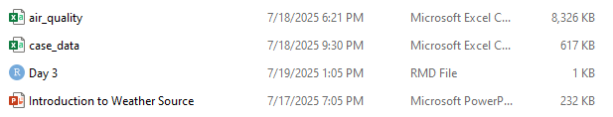
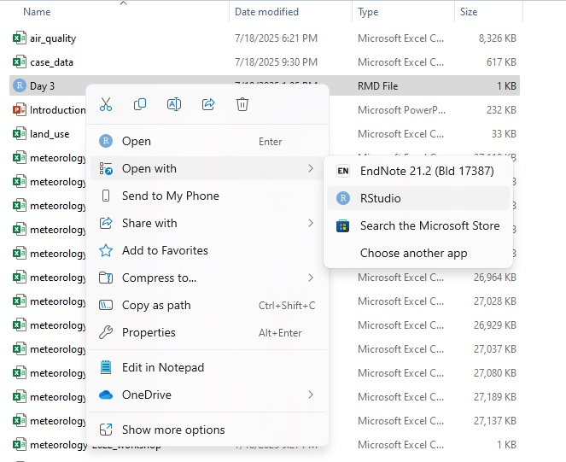
In Windows: Right click on the file and select “Open with.” Choose RStudio or, if it is not listed, select “Choose another app” and find RStudio in the list.
In MAC: select the file, open its “Get Info” window, and change the “Open with” setting to RStudio. Click “Change all.”

Slide 4
Why R Markdown
R Markdown is used to combine text, images, and R code in one document.
It can be “knit” into HTML files, Word documents, presentation slides, or PDFs.
For our purposes, it is just a nicer way to include text and code in one file for easier reading, rather than seeing a lot of #comments in regular R code.

Slide 5
What to look for
The top of the document will give R Markdown instructions on how to output the document (the default is an HTML file). It will also have the title of the document, the author, and the date.
You can ignore that section.
The rest of the document will be text, just like in Word, or code chunks that you can run.

Slide 6
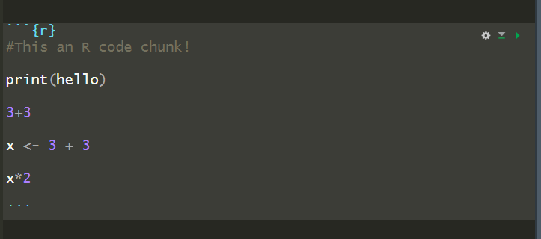

Example code chunk
```{r} tells R that a code chunk follows
You can run the entire code chunk by selecting the green arrow
OR
You can run code line by line by highlighting it and selecting “Run” at the top of the window
``` closes the code chunk so you can continue with plain text

